Slide 1
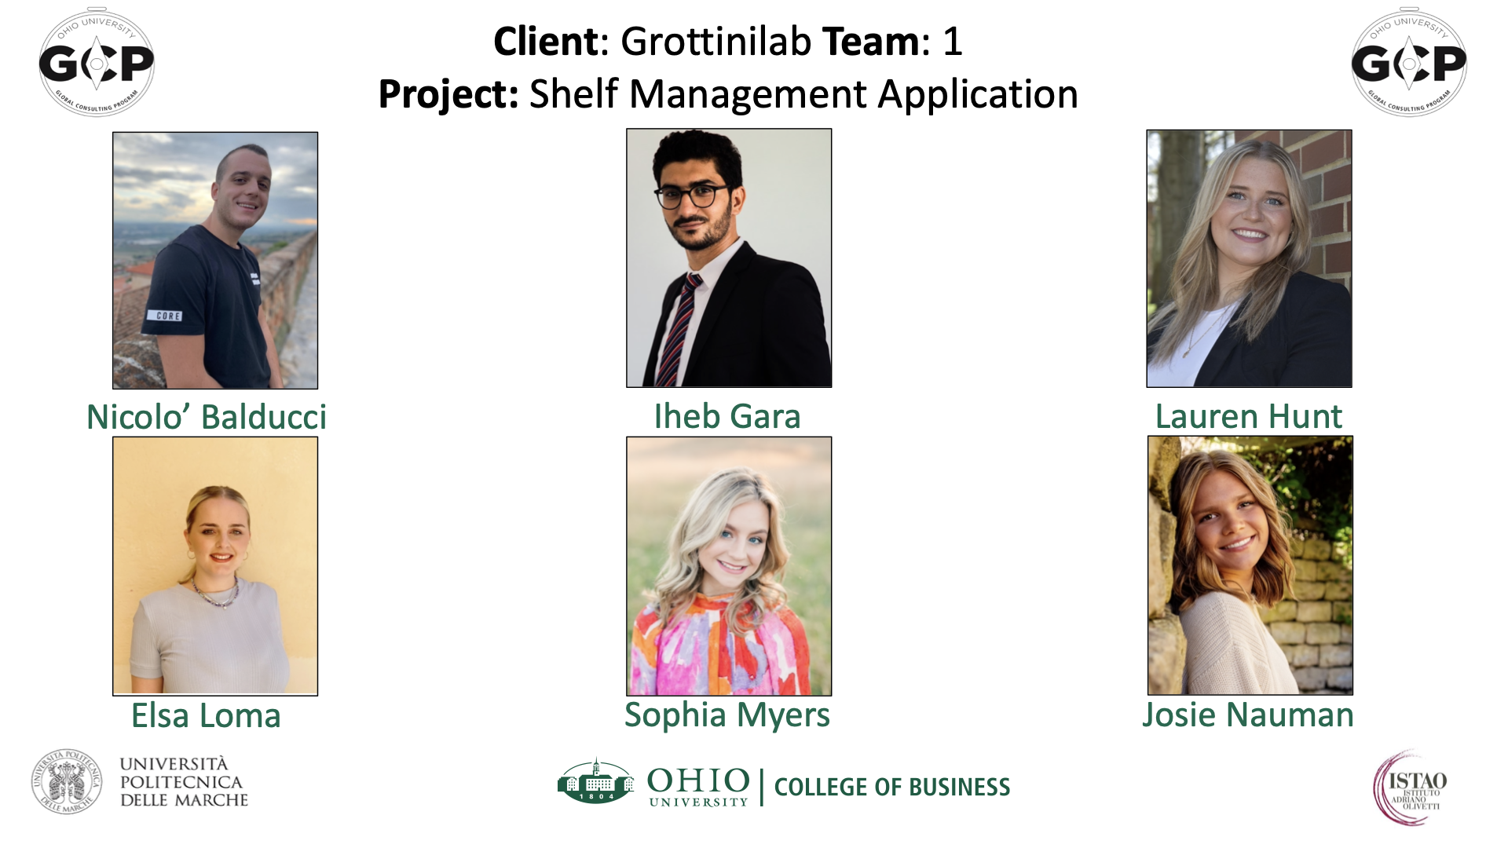

Slide 2


Industry Analysis & Recommendations

Slide 3




Agenda
1
Industry Analysis
Recommendations
2
3
Looking Forward
Key Takeaways
4
Notes:
Build

Slide 4
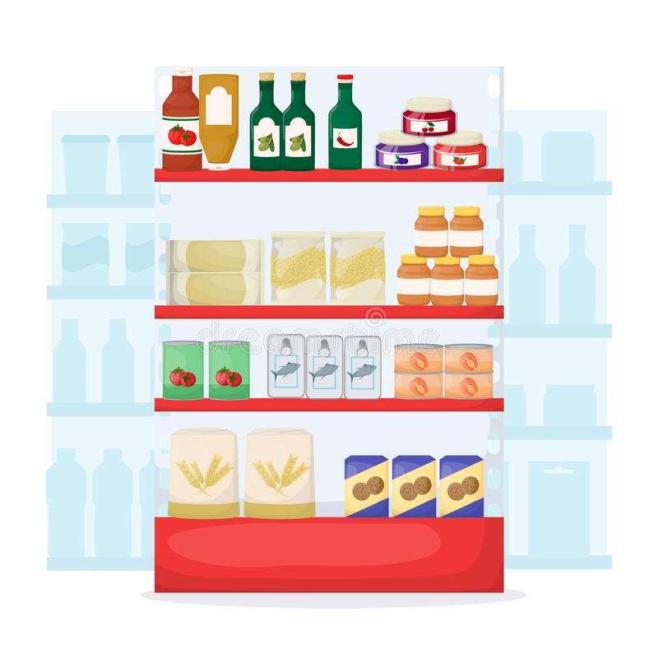

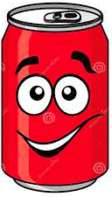
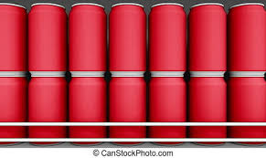

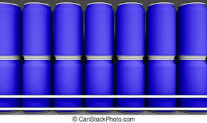
Which One would you Choose?
Brand A
Brand B
Brand A
(Parallel Dots, 2021)

Slide 5
Scope
Analyze
Website
Shelf Management APP
Improve Communication and Lead Generation
Promote Application
Find
Competitors

Slide 6

01
Industry Analysis
Industry Overview
Competitor Analysis
Company Analysis
6

Slide 7




Shelf Management Industry
Sectors
Highlifer:
evolving customer needs
Leader:
many needs
Symphony Retail AI
Focal Systems
Challenger: emerging customer needs
Outperformer: unique customer needs
Execution Strength
Eversightlabs
Grottinilabs
Market Strength
Shelf Management - ESP on CB Insights. (n.d.).
Notes:
Build

Slide 8



Competitors
International Competitors | Similarities
Italian Competitors | Similarities
Video Analytics & their own analytics measure consumer behavior
Eversightlabs
Cloud holds information
Dialogica
Symphony Retail
AI
Use Artificial Intelligence
Real time image recognition
BeMyEye
Focal Systems
Solution to enhance consumer experience

Slide 9
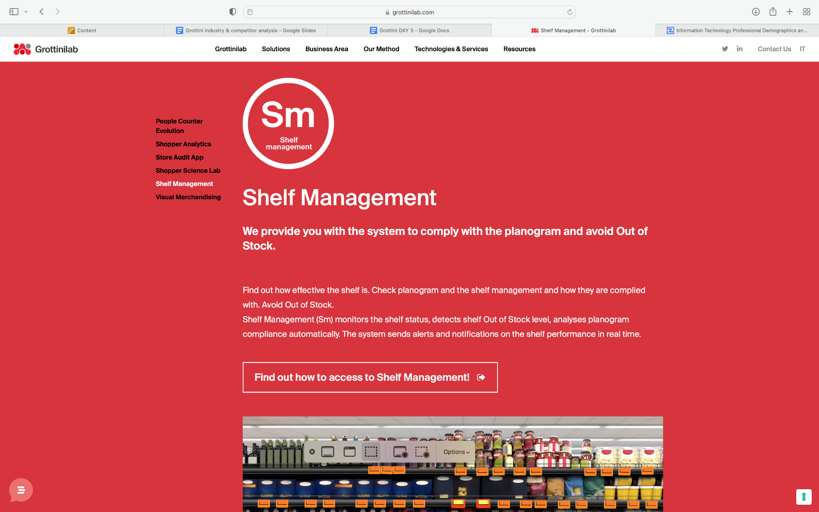
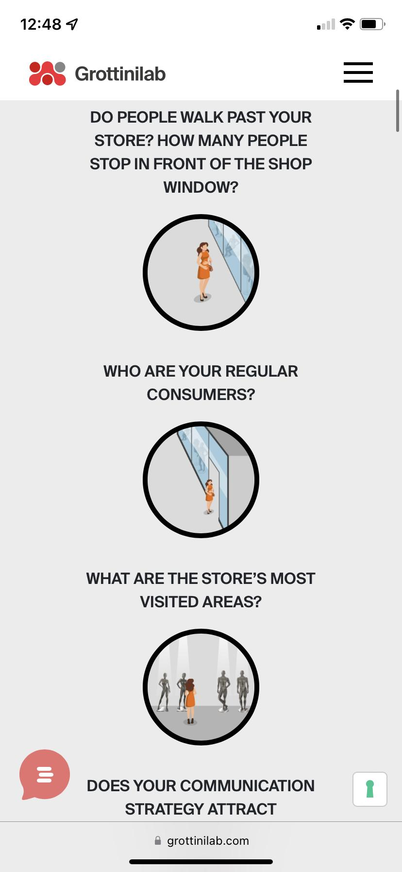
Company Analysis
Big Insights, Big Data, Big Actions
Focusing on Shelf Management
Sell data NOT technology
(Grottinilab, 2022)

Slide 10
Recommendations
Redesign Website
Creating Promotional Strategies
Attending Proposed Events

Slide 11

Recommendation 1:
Redesign Website
Merge “Our Method” with “Technologies and Services”
Menu
Homogenize UX for Menu
Pricing
Contact us
Logo in PNG
Shelf Management
Contact Us
Banner
AI Chatbot
Notes:
Build\

Slide 12
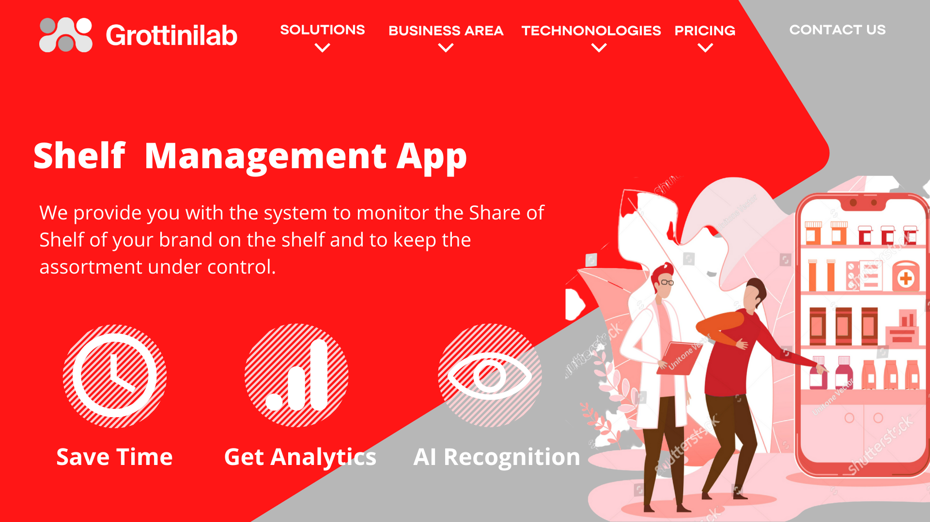
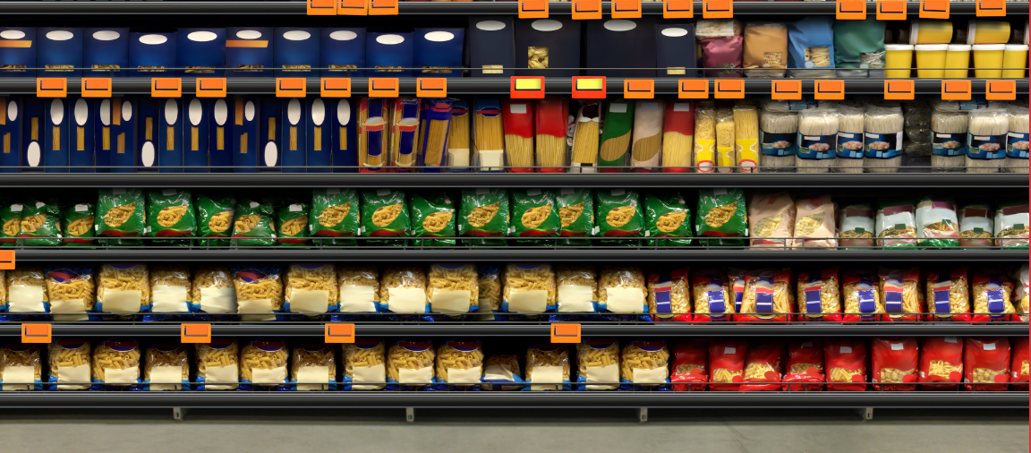

Recommendation 1:
Redesign Website
Add short motion design videos
Update language barrier
Shorten descriptions along with graphics
Keep the same design for all browsers

Slide 13
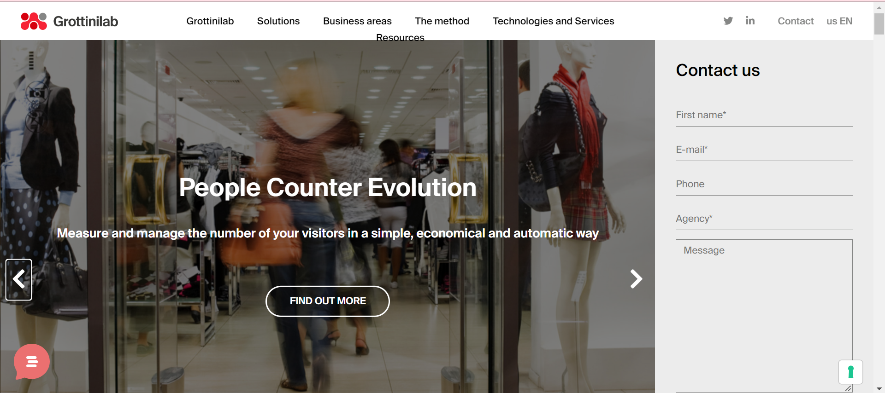
Current Website

Slide 14
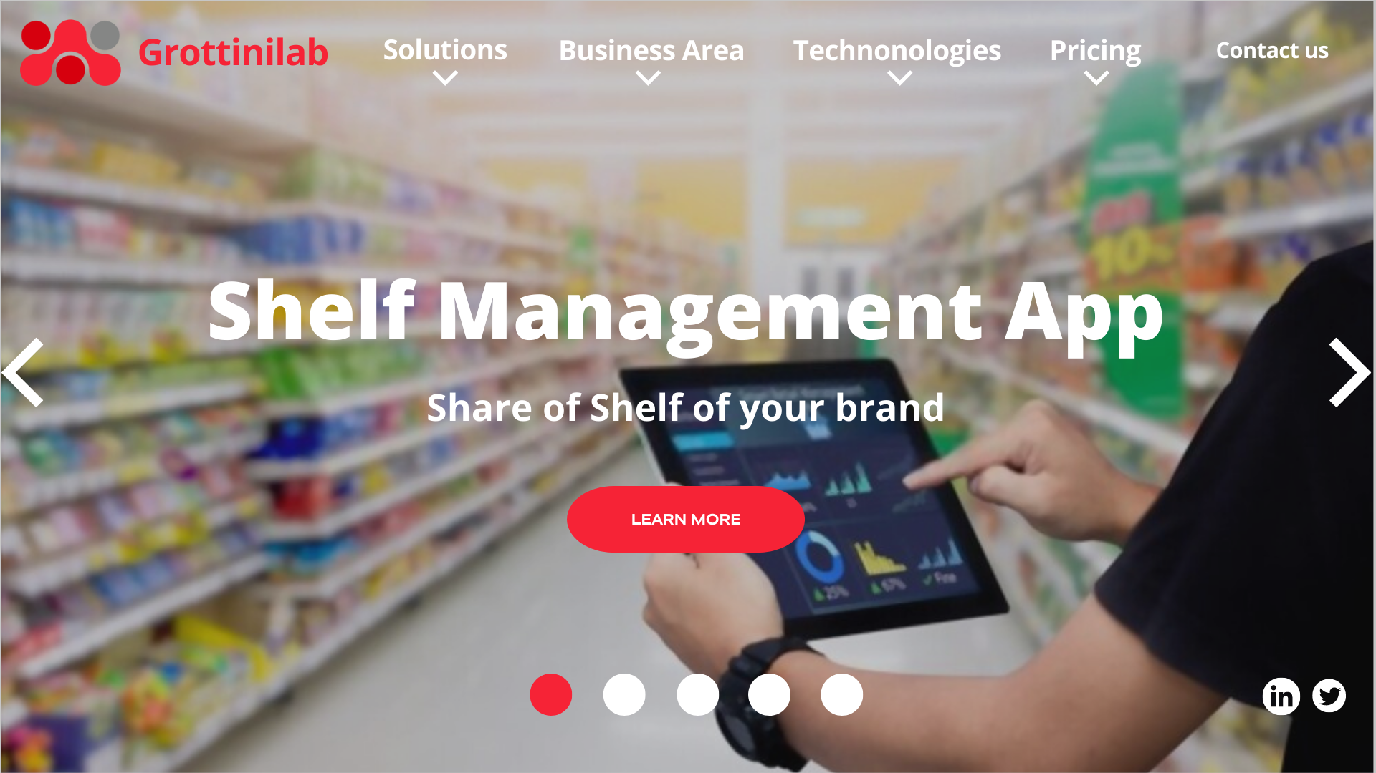

Slide 16
Recommendations
Website Redesign
Creating Promotional Strategies
Attending Proposed Events

Slide 17



Recommendation 2:
Creating Promotional Strategies
Citation: Worldstream (2022, June 22) Social Media Today(2014, January 8) Maps of Arabia (2021, June 8) | Pros | Cons
Google My
Business
Views per week
“Offers” and “What’s New”
Post expire in 7 Days
Increase likeability
Promote new products
More expensive
3000 €
LinkedIn
Customer Loyalty Promotion
Does not reach new customers as easily
Repeat customers
Less expensive
Notes:
Create Promotional

Slide 18
Recommendations
Website Redesign
Creating Promotional Strategies
Attending Proposed Events

Slide 19


Recommendation 3:
Events for Improving Promotion and Communication
Webinars
Expos
Notes:
Verb in title, recommendation 3

Slide 20

Webinars
(Flynn, 2022)
(Cobb, 2022)
Average 500-1000 leads after
Average conversion rate of 55%
83% of marketers find effective
Reach a wide variety of attendees
LiveStorm
Webinar
Software
38€ / host
Price Range:
46 € - 142€

Slide 21
Expos
(Expo Display Service)
74% of attendees most likely buy products/services
Build networking and strengthen existing customers
Speak directly to target market, Introduce new products/services
Average Cost to visit an exhibition:
 | Standard Ticket | Premium Ticket
Prices | 13 € | 73 €
Features | unlimited entries 10 Smart Queue Bookings/ day | Standard ticket Premium lounge Priority access Valet parking
(Wego Travel Blog, 2022)

Slide 22
Timeline of Expos in Europe & U.S
CNR FOOD ISTANBUL
FOOD EXPO GREECE
ANUGA COLOGNE
SIAL PARIS
19-22 March 2024
31 Aug - 3 Sep 2022
19 Oct 2022
10-20 March 2023
12-13 Sep 2022
8-10 Feb 2023
23-25 Oct 2023
America’s Food and Beverage Show
FRUIT LOGISTICA BERLIN
PROCESS EXPO FPSA - CHICAGO

Slide 23
03
Looking Forward
Implemental Costs
Whats Next
Expected Value

Slide 24
Total Projected Cost
Event | Details | Cost (EUR)
Expo 1 | Standard Ticket Hotel | 13 € 450 €
Expo 2 | Standard Ticket Hotel | 13 € 450 €
Expo 3 | Premium Ticket Hotel | 73 € 450 €
Expo 4 | Premium Ticket Hotel | 73 € 450 €
Webinar 1 | Host | 38 €
Webinar 2 | Attend | 117 €
Webinar 3 | Attend | 50 €
Event | Details | Cost (EUR)
Other | Business Cards | 50 €
LinkedIn | Promotional ads | 3000 €
Redesign Website | Fresh Interface | 1000 €
Estimated Total Cost per Year | 6227 €

Slide 25
Expected Overall Value
Website Redesign
Grottinilab Image Recognition
Promotional Strategies
Increased Sales
Events to attend
Grottinilab Brand Reputation

Slide 26
Bringing it All Together
Convenient Recommendations
Promising Industry
Brand Reputation
Maximized Impact
Notes:
Overall, IT consulting is a promising industry
Share of Shelf image recognition tool is a great solution for tracking performance in the market
GrottiniLab holds a strong brand reputation in this industry
And these are the 3 keys for a successful project

Slide 27
SOURCES
Barker, S. (2022, April 12). 23 webinar hosting websites you need to know right now. Shane Barker. Retrieved July 7, 2022, from https://shanebarker.com/blog/webinar-hosting-websites/#1_Livestorm
Chaudhuri, A. P. (n.d.). Importance of IT consultants in businesses. Importance Of IT Consultants In Businesses. Retrieved June 30, 2022, from https://www.consultantsreview.com/news/importance
Crea il tuo biglietto da visita personalizzato in Pochi minuti. Vistaprint. (n.d.). Retrieved July 6, 2022, from https://www.vistaprint.it/mlp/biglietti-da-visita-1?PCXTVATINCLUSIVE=&utm_id=2B12581883370518735884&coupon=&partner=google&ps_vtp=7923211%7C7726234163%7C%7Ckwd-10164130%7Cc%7C1008033%7C%7Cg&ps_vtp2=g%7Cbusiness+cards%7Cp%7C574249417424%7C%7C%7C%7C%7C&gclid=Cj0KCQjw5ZSWBhCVARIsALERCvzTIBBKboqqNBbUdxEZHUV99Y7NEHHK7Ov7amH9LlA9Cb_LB-O3eyEaAotFEALw_wcB
Eversight's strong fiscal year close propels Q1 momentum. Business Wire. (2022, May 4). Retrieved June 30, 2022, from www.businesswire.com/news/home
Focal Systems. (2022, February 7). Focal Systems Inc - $9,000,000 Revenue. Kona Equity. Retrieved June 30, 2022, from https://www.konaequity.com/company/
Food i̇stanbul. [ CNR EXPO ] CNR Food Ä°stanbul GÄ±da ve Ä°Ã§ecek ÃrÃ¼nleri, GÄ±da Ä°Åleme, Depolama, SoÄutma, TaÅÄ±ma ve Market EkipmanlarÄ± FuarÄ±. (n.d.). Retrieved July 6, 2022, from https://cnrfoodistanbul.com/index.aspx?ln=2
GDP growth (annual %) - italy. Data. (n.d.). Retrieved June 30, 2022, from https://data.worldbank.org/
Gérard, C. (2022, February 17). Supercharge your retail execution. BeMyEye. Retrieved June 30, 2022, from https://bemyeye.com/

Slide 28
SOURCES
Grottinilab.” Grottini Lab Srl, 2022. https://www.grottinilab.com/en/
Hayes, A. (2022, May 6). What video marketers should know in 2022, according to Wyzowl Research. HubSpot Blog. Retrieved July 7, 2022, from https://blog.hubspot.com/marketing/state-of-video-marketing-new-data
Hughes, B. (2014, January 8). Five benefits of using linkedin to grow your business and your career. Social Media Today. Retrieved July 7, 2022, from https://www.socialmediatoday.com/content/five-benefits
Johnson, S. (n.d.). 15 LinkedIn Marketing Tips to grow your business . Business News Daily. Retrieved July 7, 2022, from https://www.businessnewsdaily.com/7206-linkedin-marketing-business.html
ParallelDots ParallelDots Published Oct 23. (2021, October 23). Share of shelf execution with image recognition – calculation for increased market share. LinkedIn. Retrieved June 30, 2022, from https://www.linkedin.com/pulse/share-shelf-execution-image-recognition-calculation-increased-/
Pernpruner, M. (n.d.). dialogica.it. Retrieved June 30, 2022, from www.dialogica.it/en/index.php
Puchkov, J. V. (2021, October 15). Youth unemployment in Italy. Pressenza. Retrieved June 30, 2022, from https://www.pressenza.com/2021/10t
Reports, V. (2021, October 6). Smart shelves market size to reach USD 6.5 billion by 2027 at cagr 10.47% - valuates reports. Smart Shelves Market Size to Reach USD 6.5 Billion by 2027 at CAGR 10.47% - Valuates Reports. Retrieved June 30, 2022, from www.prnewswire.com/in/news-releases/smart-shelves-market

Slide 29
SOURCES
Rjoub, R. (2021, December 16). The impact of digital marketing on consumer behaviour 2021. Maps of Arabia - SEO Agency. Retrieved July 6, 2022, from https://mapsofarabia.com/the-impact-of-digital-marketing-on-consumer-behaviour/
Shelf management. Shelf Management - ESP on CB Insights. (n.d.). Retrieved June 30, 2022, from www.cbinsights.com/esp/consumer-&-retail/store-management/shelf-management
Statistics explained. Statistics Explained. (n.d.). Retrieved June 30, 2022, from https://ec.europa.eu/eurostat/statistics-xplained
Suárez, M. G., & Rubio, N. (n.d.). Shelf Management of store brands: Analysis of manufacturers' perceptions. Research gate . Retrieved June 30, 2022, from www.researchgate.net/publication/235260529_Shelf_management
IHow to become an information technology professional in 2022: Step by step guide and career paths. Zippia. (2022, May 26). Retrieved June 30, 2022, from https://www.zippia.com/information-technology-professional-jobs/
Indeed Editorial Team. (2021, August 18). 11 types of marketing events for a business to host. Indeed Career Guide. Retrieved July 6, 2022, from https://www.indeed.com/career-advice/career-development/types-of-marketing-events
taly inflation rate. Italy Inflation Rate | Inflation Rate and Consumer Price Index. (n.d.). Retrieved June 30, 2022, from https://www.rateinflation.com/inflation-rate/italy
La Digitalizzazione delle imprese in Italia. Askanews. (2022, March 2). Retrieved June 30, 2022, from https://www.askanews.it/scienza-e-innovazione/2022/03/02/

Slide 30
SOURCES
Marketing, O. (2014, August 8). Culture as competitive advantage for marketers. Forbes. Retrieved June 30, 2022, from www.forbes.com/sites/onmarketing
McCormick, K. (2022, June 22). 12 ways to effectively promote a new product or service. WordStream. Retrieved July 6, 2022, from https://www.wordstream.com/blog/ws/2020/07/29/how-to-promote-a-product
Milanov, M. (2021, June 25). Biggest trade fairs - the food industry. Fair Point GmbH. Retrieved July 6, 2022, from https://www.fair-point.com/blog/biggest-trade-fairs-the-food-industry-part
Symphony RetailAI. (2020, June 30). Symphony retailai included in Overview report by top independent research firm on customer analytics providers. GlobeNewswire News Room. Retrieved June 30, 2022, from https://www.globenewswire.com/en/news-release
Travel, W. (2022, March 2). Expo 2020 tickets: Price, offers, & more *updated 2 March 2022*. Wego Travel Blog. Retrieved July 6, 2022,https://blog.wego.com/expo-2020-dubai-tickets/#:~:text=Premium%20Experience%20SE%201%2DDay%20Ticket,-The%20premium%20experience&text=The%20price%20for%20adults%20(18,AED%20275%20(USD%2074.87).
What will it cost to participate in an exhibition? Expo Display Service. (2020, March 3). Retrieved July 6, 2022, https://www.expodisplayservice.com/cost-participate-exhibition/

Slide 31
04
Appendices

Slide 32
SWOT Analysis
Appendix A
S
W
Only company in Italy designated to have an internal certified authorisation for customs clearance.
Quality control department for both raw materials and components.
High Costs
It is difficult to implement this sophisticated system and provide it to retaliators
O
T
Increasing collaboration with retail stores
The shelf management app helps to better manage the company field sales team
Inability to reach some retailers
Bureaucracy

Slide 33
PESTEL Analysis
Appendix B
POLITICAL
ECONOMIC
SOCIAL
TECHNOLOGICAL
LEGAL
-Stability and Growth Pact
-Liberality of markets in the EU
-Bureaucracy restrictions for patents application
-High levels of taxation
-Population Growth
-Age Distribution
-Educational level
-Cultural Needs
-Digital transformation for companies in Italy
-Better technological infrastructure for innovative companies
-Employment law
-EU-US
Privacy Shield,
-Personal
data protection
-Low GDP comparing to countries in Europe
-High level of inflation
-Absence of Exchange rates in European Union

Slide 34
Appendix C
Porter Analysis- Grottinilab
BUYER POWER
Grottinilab expressly stated that buyer power is high, this is because in order to "expand market share", the company itself has promoted and tried to promote its service to various manufacturers.
SUPPLIER POWER
Grottinilab does not have any suppliers for the Shelf Management Service other than Amazon for space and computing power for the cloud.
RIVALRY AMONG EXISTING COMPETITORS
The rivalry among existing competitors is relatively high, given that other companies in Europe, such as Bemyeye in Britain and Dialogica in Italy, offer the same product.
THREAT OF ENTRY
In the IT technology sector, barriers to entry can be a problem for 'new entrants' as they are very high.
THREAT OF SUBSTITUTES
In the IT sector in which GrottiniLab operates, the threat of substitution can be described as fairly low. This is because 'generally' external companies do not offer more attractive and/or low-cost products.

Slide 35
Global Outlook
Appendix D
Liberality of markets in the EU
Bureaucracy restrictions for patents applications
Stability and Growth Pact
High levels of taxation

Slide 36
Technological
Appendix E
Digital transformation for companies in Italy
60.3%
Better technological infrastructure for innovative companies
La Digitalizzazione delle imprese in Italia. (2022).

Slide 37
The Effects of Legislation on
the Industry and the Company
Appendix F
Positive | Negative
Employment law | Personal data protection Techniques as encryption protocols
EU-US Privacy Shield

Slide 38
Economical Aspects
Influencing the Company
LOW GDP COMPARING TO COUNTRIES IN EUROPE
HIGH LEVEL OF INFLATION
ABSENCE OF EXCHANGE RATES IN EU
HIGH YOUTH UNEMPLOYMENT
Appendix G
Inflation rate in Italy achieved 7.3% in May 2022.
Italy’s GDP is ranked as the 33rd out of 45 European countries
Countries in the EU do not require exchange rates.
Lack of skills
Non-compliance with the labour market
.

Slide 39
Environment of the Industry
Appendix H
Citations: How to become an information technology professional (2022) Marketing, O. (2014, August 8) How to become an information technology professional in (2022) Statistics explained. Statistics Explained. (n.d.) Chaudhuri, A. P. (n.d.). | Informational Technology Consulting | Marketing Consulting
Consultant Growth | expects to grow 9% | expects to grow 20%
Age Distribution | ages range from 35-44 | ages range from 31-39
Educational Level | 64% bachelors 17% associates | 75% bachelors 13% masters
Cultural Need | Manufactures are dependent on skills of Informational technology consultants | Marketing utilizes culture to be relevant and efficient

Slide 40

Technology Trends
Appendix I
Artificial Intelligence
Infrared Systems
Clouds to hold information
Image Recognition

Slide 41

Manufacturers
Appendix J
Increasing Sales with allocation of products
Gaining competitive edge
Monitoring stock positioning and quantity
Grottinilab comes to the rescue with their app

Slide 42
Webinars
Appendix K
At least 83% of U.S. marketers find webinars effective.
However, since the start of the COVID-19 Pandemic, companies have seen up to an 87% increase in attendance.
The average webinar generates between 500-1,000 leads.
The average webinar attendee conversion rate is 55%.
Livestorm, $39.00/month per host. they do have a free plan
don't require you to rent out a venue and can reach a wide array of attendees who don't have to physically travel to the event
Average price of 46 - 142 eur

Slide 43
Expos
Appendix L
Businesses are also starting to do hybrid events as well.
74% of attendees believe engaging with the exhibitors makes them more likely to actually buy the products/services on display.
49% of trade show attendees plan to buy at least one of the products or services on display.
U.S. businesses plan to attend an average of 7.8 international trade shows every year.

Slide 44
Creating Promotional Strategies
Appendix M
Customer loyalty program
Google MyBusiness
LinkedIn
By implementing this strategy Grottinilabs will be able to skip educating the brand and cut the company a good deal. Market metrics, the probability of companies selling to existing customers. By doing this it allows Grottinilab to have an effective way to promote their new product without spending money. Market Metrics research has shown, 60-70% of sales are to existing customers, the other 5-20% are new customers. This type of promotion also is essential for long-term profitability. Gartner Group has concluded that 80% of a company’s future revenue will come from only 20% of the company’s existing customers.
This form of promotion is a free website ran by Google that allows the company to post often, stay in touch with their clients, and receive feedback. Within the “What’s new” tab Grottinilab to promote what is going on inside the company, ie. the new product. Although the post does expire in 7 days, it allows the company to keep their consumers updated on a weekly basis.
LinkedIn is a source that Grottinilab already utilizes. The benefits of LinkedIn include, the accessibilities to connect with other companies, the post never expire, and the easy access to clients. We believe if Grottinilab utilizes this resource to the greatest extent they will be able to promote their product efficiently and at a low cost. This source can also increase the likeability of the company.

Slide 45
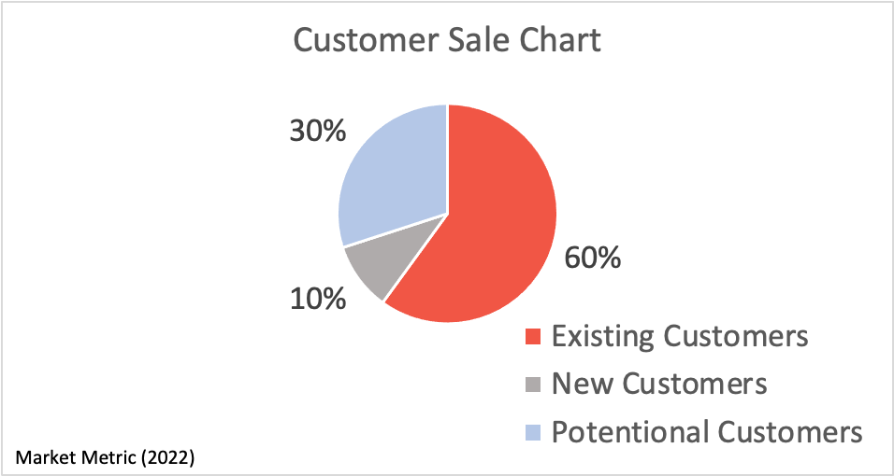
Customer Loyalty Promotion
Appendix N

Slide 46
Appendix O
EXPO IN EUROPE
CNR Food Istanbul - Turkey
FRUIT LOGISTICA - Berlin
ANUGA- Cologne Germany
SIAL PARIS
FOOD EXPO GREECE
47.513 Industry Professionals
2.000 Brands
From 20 Countries
Visitors: 72,706
Exhibitor: 3,335
Visitors: Asia, Australia, Europe, North & South America
Visitor Count: 169,653
Exhibitor 7,972 From 106 Country
Visitors from: Europe, Asia, Africa, Australia
Visitor: 140,000
Exhibitor: 7,000
Largest exhibition held in the French capital
Visitor: 70,000
Exhibitor: 28,250
Food Expo Greece is the fastest-growing food show on the planet and is getting better with each new edition.

Slide 47
EXPO IN U.S
Appendix P
America’s Food and Beverage Show
Process Expo- FPSA
Around 45% of all exhibitors and guests are from North America
40% are from Latin America and the Caribbean
15% From Europe, Africa and Asia
Visitors: 20,000
Exhibitors: 3350
This expo represents the pinnacle of food technology, bringing together some of the world’s most successful processors.

Slide 48
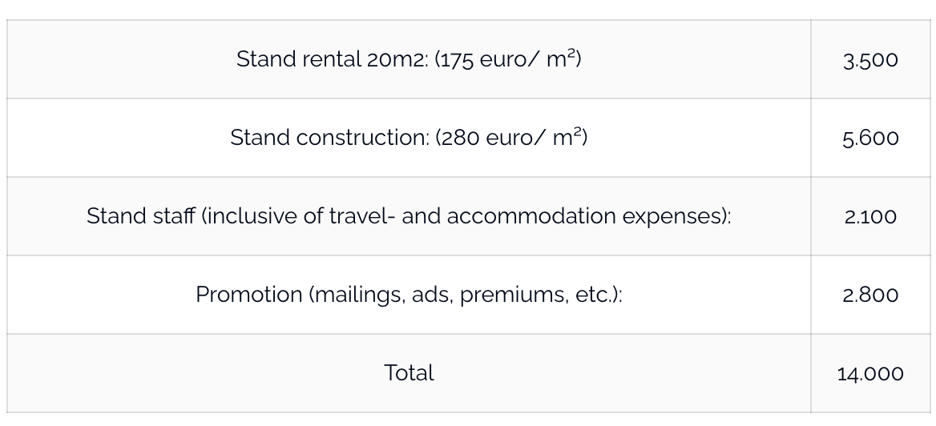
The Cost of Placement at Expo
Appendix Q

Slide 49

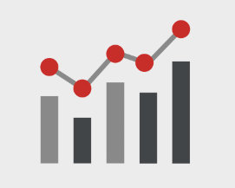

3 KEY FACTORS
BIG INSIGHTS
BIG DATA
BIG ACTIONS
Appendix R
Customer’s needs
Collecting data
Answering Business Questions

